Slide 1
Value Proposition, Company Description, Business Structure

Slide 2
Value Proposition
What (your product or service)
To Whom (your customer)
Why (your competitive advantage)
Introduction
Notes:
30 second elevator speech to a stranger.
Grandmother should be able to understand the value proposition.

Slide 3




Value Proposition
Dimensions of Value
Innovative Offering
A better mousetrap
Features
Performance
Packaging
Introduction

Slide 4



Value Proposition
Dimensions of Value
Lower Cost
The same, for less
Introduction

Slide 5



Value Proposition
Dimensions of Value
Quality, Reliability
Best quality
Introduction

Slide 6



Value Proposition
Dimensions of Value
Customer Responsiveness
Customer is #1
Introduction

Slide 7

Value Proposition
Dimensions of Value
Unique Niche
  Location
  Customer Knowledge
  Specialized Know-How
Local is Better
Introduction

Slide 8

Value Proposition
What (your product or service)
To Whom (your customer)
Why (your competitive advantage)
Introduction
Notes:
30 second elevator speech to a stranger.
Grandmother should be able to understand the value proposition.

Slide 9

Business Plan
10 Steps
Executive Summary
Value Proposition
Company Description
Market Description & Opportunity Assessment
Product/Service Description
Competitive Assessment
Marketing & Sales Strategy
Operations
Management and Employees
Financial Summary
Company Description
Notes:
This particular organization is based on developmental order.

Slide 10

Company Description
Business Name
Business Structure
Licensing
Founders/Management Team
Boards of Directors and/or Advisors
Intellectual Property
Physical Property
Company Description

Slide 11



What’s in a Name?
Easy to remember
Simple to spell & pronounce
Says what you do
Stirs interest
Eliminates confusion
Evokes an image
Shouldn’t limit your options
Available internet domain
Company Description

Slide 12
Good Names?
Twitch → ??
Page Rank → Back Rub → ??
Company Description

Slide 13

Business Name
A sole proprietor can use his/her “real and true” name
  John Q. Public
No nicknames or terms that suggest partners
  Company, Associates
All others must register an assumed business name
  Sole proprietor may also register an assumed business name
  Must be unique and distinguishable
Certain business forms require suffix
  LLC, Inc.
Search available names and register
  www.filinginoregon.com
Company Description

Slide 14




Business Name
Intent is to avoid confusion…
John P. McDonald’s Farm
John P. McDonald’s
Landscaping
John P. McDonald’s Hamburgers
???
Company Description

Slide 15

Business Name
Registration of your business name and structure
www.filinginoregon.com
Company Description

Slide 16
Importance of Business Structure
Defines Legal & Business Format
  Management & Control
  Allocation of Profits (Losses)
  Assumption of Risk
  Agency Relationships
Tax Structure
Liability
Record Keeping and Reporting
Capitalization, Expansion, Transitions
Company Description

Slide 17
Caveats
Important to talk to a lawyer because:
No single right answer
Many choices
Exceptions to every rule
Mechanisms to make any structure work
Law is constantly changing
Circumstances change
Structure can change
Consult legal and tax professionals!!!
Company Description

Slide 18

Sole Proprietor
Definition
  One person operating a business as an individual
  Single owner/manager who assumes all of the risks and reaps all of the rewards
  No separate legal entity formed
  No state/federal registration
  2/3rds of all businesses; 86% of farms/ranches
Company Description

Slide 19
Sole Proprietor
Advantages
  Easiest to form & dissolve
Company Description

Slide 20

Sole Proprietor
Rent stall at Farmer’s Market
Congratulations, you’re a Sole Proprietor!
Company Description

Slide 21
Sole Proprietor
Advantages
  Easiest to form & dissolve
  Greatest management freedom
  Absolute control
  Proprietor receives all profits
  Little/no government regulation
  Business losses can offset other income
Disadvantages
  Absorb all losses
  Limited financing options
  Unlimited liability
  Attracting employees
  Business continuity
Company Description

Slide 22


Sole Proprietor
Unlimited Liability
Bull wanders off property and onto highway
Accident occurs
Your liability is not limited
Cuts both ways
Default on personal car loan
Your business assets at risk
Company Description

Slide 23
General Partnership
Definition
  An agreement between two or more persons to carry on a business for profit
  Agreement can be implied, oral or written (should be written)
  Share profits, losses, ownership, and management
  Equal access to books and records
Company Description

Slide 24
General Partnership
Advantages
  Easy to form
Company Description

Slide 25
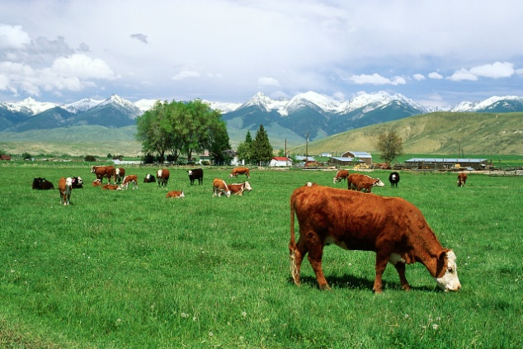

General Partnership
Orally agree to raise heifers
  Friend buys heifers
  You provide feed
Congratulations, you’ve formed a partnership!
Company Description

Slide 26
General Partnership
Advantages
  Easy to form
  Pool resources – assets and expertise
  Business losses can offset other income
Disadvantages
  Requires detailed partnership agreement
  Limited financing options
  Joint & several unlimited liability
Company Description

Slide 27

General Partnership
Joint and several unlimited liability
You grow produce, your partner takes to markets
Your partner gets in accident while delivering produce
Your personal assets are at risk
Injured party can sue either partner for any liability!
Company Description

Slide 28
General Partnership
Advantages
  Easy to form
  Pool resources – assets and expertise
  Business losses can offset other income
Disadvantages
  Requires detailed partnership agreement
  Limited financing options
  Joint & several unlimited liability
  Business continuity
Company Description

Slide 29


General Partnership
Business Continuity
  Dissolved upon death
Personal Events of Either Partner can Dissolve Partnership
  Divorce
  Bankruptcy
  Health
Company Description

Slide 30
Limited Partnership
Definition
  An agreement between two or more persons to carry on a business for profit – like a Partnership, but…
  General Partner assumes greater control over decision making, has unlimited upside/downside
  Limited Partner(s) only receive a described share of profits and liability is proportional to investment
Company Description

Slide 31

Limited Liability Company
Definition
  Hybrid combining the limited liability aspects of a corporation and tax advantages of a partnership
  One or more principals
  Creates an “informational” entity
Company Description

Slide 32
Limited Liability Company
Advantages
  Pool resources – assets and expertise
  Limits liability to member investment
  Earnings can be passed to members or retained
  Can be taxed as partnership or corporation
  More financing options
  Member or manager managed
Disadvantages
  Requires filing with state
Company Description

Slide 33
Corporation
Definition
  A new and separate legal entity from its owners, managers, and employees
  EIN
  One or more shareowners
  Stands independently from owners
  Separate tax laws and structure
Company Description

Slide 34

Corporation
Advantages
  Pool resources – assets and expertise
  Limits liability to shareowner investment
  Earnings can be passed to owners or retained
  Most financing options
  Classes of shareowners
  Continuity
Disadvantages
  Requires filing with state
  Requires creation of specific roles/responsibilities
  Complicated accounting and records requirements
  Double taxation
  Salary vs dividends
Company Description

Slide 35


Corporation
Double taxation
  Dividends
Corporate Profits Taxed
&
Dividends Distributed
from Corporate Profits
Company Description

Slide 36
Other Forms
Cooperative
  A corporation where profits are allocated on basis of transactions rather than investment.
Limited Liability Partnership (LLP)
  Like an LLC, but for professional service organizations
Family Limited Partnership
  Limits liability and can (in some states) exempt partners from real estate transfer taxes
Subchapter “S” Corporation
  Corporation meeting certain criteria qualifying for special tax treatment (like a partnership)
Company Description

Slide 37

“S” Corporation
Special tax considerations
  Taxed like partnership
  No double taxation of dividends
Profits/losses allocated solely on basis of shareholder interest
No more than 75 shareowners
Single class of stock
All stockholders must be individuals
Company Description

Slide 38
S Corp vs LLC
Clearly Defined Business Continuity
Easier to Form
More Flexible Operating
Tax Flexibility
Limited Liability
Very similar advantages
Company Description

Slide 39
S Corp vs LLC
Arcane Differences
LLC – all member income subject to 15.3% federal self employment tax
S Corp – Only market competitive salary subjected to payroll tax. Excess profits can be distributed as corporate distributions rather than salary
Payroll taxes must be filed monthly while self employment taxes due annually. S Corps have higher accounting overhead
Demonstrates need for professional tax council
And, neither structure obviates need for good partner agreements
Company Description

Slide 40
Non Profit Corporation
A non-stock corporation formed for religious, charitable, educational, literary, or scientific purpose
Must meet state requirements
Must meet IRS 501(c)(3) regulations
No shares of stock issued
At dissolution, assets transfer to other nonprofit
Company Description

Slide 41
Non Profit Corporation
Advantages
  Tax exemption from most federal and state taxes
  Limited liability for members and directors
  Able to receive donations
Disadvantages
  Complex requirements
  Complex paperwork and record keeping
  Federal and state filings
  Limits on activities
Company Description
Notes:
Very complex (and arcane) tax differences between the two. Example – in an LLC, all member income is subject to 15.3% federal self employment tax. In an S Corp, only the market competitive salary is subjected to payroll taxes. Further profits can be paid as corporate distributions and not subject to self employment tax. In good years, this could amount to substantial tax obligation differences.
But, payroll taxes require monthly filing while self employment taxes are due only annually. S Corps have higher accounting overhead.
Shows the need for professional tax counsel.
Corporations and LLCs do not obviate the need for good owner agreements.

Slide 42


Non Profit Corporation
More information on non-profits
www.filinginoregon.com/business/nonfprofit_information.htm
Company Description

Slide 43
Structure Summary
 | Sole Proprietor | General Partnership | LLC | S Corporation
Formation | Easy No state filing | Moderate No state filing | Moderate State filing | High State filing Federal election
Ownership | One owner | Two or more; Divided by agreement | One or more; Divided by agreement | One to 100; Proportional to Investment
Term | Terminated upon closure or death | Dissolves upon death | Perpetual | Perpetual
Liability | Unlimited | Joint and Several Unlimited | Limited | Limited
Business Operations Ease | Easy | Easy | Moderate; Annual Report | Complex; Annual mtgs, reports
Taxation | Pass through; Self emp. tax | Pass through; Self emp. tax | Pass through or Corp. Rates | Salary pass through; shareholder distr.
Transferability | No | With unanimous agreement | Yes | Yes
Company Description

Slide 44
Structure Summary www.irs.gov
 | Sole Proprietor | General Partnership | LLC | S Corporation
Basic Tax Forms and Schedules | 1040 Sched C Sched F Sched SE | 1065 Sched K1 | 1040 Sched C Sched F Sched SE | 1120S Sched K1
Estimated Tax Payments | 1040 ES | 1040 ES | 1040 ES | 1120 W
Employment Taxes | 940 941 | Same | Same | Same
Publications | 334 | 541 | 8832 | 1120S 2553
Company Description

Slide 45

How to Choose?
Degree of Desired Control
  Number of Owners
Vision for Growth
  Need for Capital
  Employees
  Geographic Reach
Liability of Owners
Taxes
Asset Base
  Type and Longevity
  Intellectual Property
Complexity of Business
Transition Planning
Ease of Formation
Company Description

Slide 46
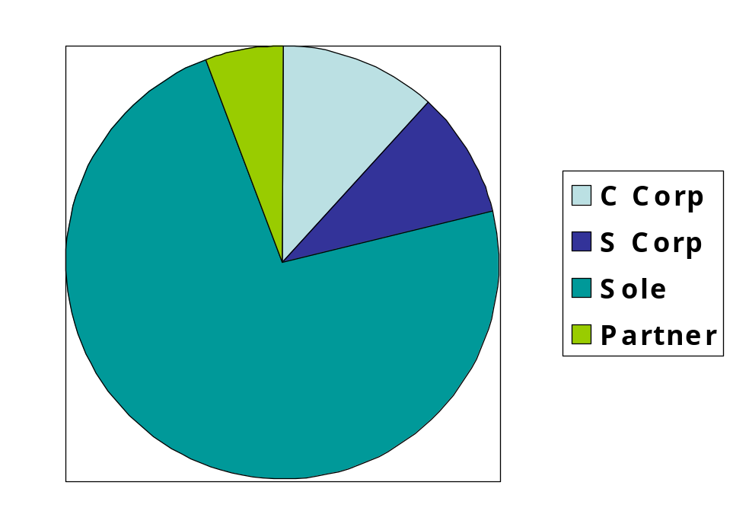
US Businesses
By enterprises (not revenues)
LLC not represented (tracking passes through)
Average Revenues
C Corp $5.8M
S Corp $1.5M
Sole Prop $58K
Partnership $166K
Company Description

Slide 47



Business Licenses
No general Oregon business license
May be local license requirement – call City Hall
Many activities do require licenses, permits, or certifications
Company Description

Slide 48

Occupational Licenses
State requirement for certification and license
Construction Contractors
Pesticide Applicator
Irrigation Installers/Repairers
Insurance and Financial Planning
Searchable list: http://licenseinfo.oregon.gov/
Company Description

Slide 49

Surety Bonds and/or Insurance
Certain business require the posting of surety bonds – most common is construction contractors
Surety bond – financial deposit with state to cover state ordered damages
Proof of general liability insurance on record with state
Company Description

Slide 50






Business Certifications
Not legal requirement
But, lend credibility to your business
  Better Business Bureau
  City Chambers of Commerce
  Industry Associations
Company Description

Slide 51
Zoning/Land Use
Defines what activities can be conducted on property
Contact city and county office
Conditional Use Permitting
Company Description

Slide 52


Founder(s) Profile
Business History of Key Participants
  Biography
  Education
  Business Management Experience
  Industry Experience
Duties/Responsibilities of Key Personnel
  Title
  Authority
Company Description

Slide 53

Boards
Board of Directors required for all Corporations
Board of Advisors highly recommended
  Mentors
  Investors
  Experience
  Judgment
  Credibility
  Free advise
Company Description

Slide 54
Intellectual Property
Protection of your idea, name, slogans
Licensing from others
Patents, Trademarks, Copyrights
http://www.uspto.gov/
Company Description

Slide 55
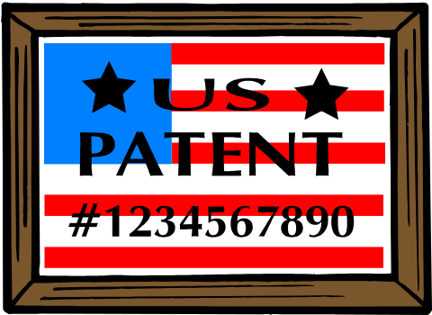
Intellectual Property
Patents
Registered exclusive right of an inventor to make, use, or sell and invention
Patents
  Design (appearance)
  Utility (new process or function)
20 years of exclusive protection
Company Description

Slide 56

Intellectual Property
Patents
Provisional Patent
  Less formal application reserving the filing for up to one year
“Patent Applied For”
Patent
  Search for “prior art”
  Reference works
  Usually involves a lawyer
  Can cost $10,000 or more!
Product Clearance Opinion
Company Description

Slide 57



Intellectual Property
Trademarks
Word, name, symbol, figure, sound, color
Associated with a company
Must be distinctive
  Coined, fanciful, arbitrary, descriptive, etc.
Registered
  Bona fide intent to use
  10 year term, renewable
Company Description

Slide 58

Intellectual Property
Copyrights
Right of an author to the exclusive use of a “work” for the life of author plus 70 years
Must be original and “fixed in a tangible medium of expression”
No notice, mark, or registration
Company Description

Slide 59





Intellectual Property
Copyrights
Literature
Music
Drama
Pantomime and choreography
Pictorial, graphic, and sculpture
Motion pictures
Sound recordings
Architecture
Not ideas, processes, methods, concepts, lettering, titles, names, unoriginal
Company Description

Slide 60

Intellectual Property
Trade Secrets
Information that is sufficiently secret to derive economic value because it is not generally known
Is actively and purposefully kept secret
Can include negative know-how (what doesn’t work)
Doesn’t need to be unique or novel
The more people who know, the weaker the rights
Vulnerable to new patent law
Company Description

Slide 61

Intellectual Property
Inventory intellectual property of your business
Intellectual property can be “banked”
Take steps to protect
  Register (patents, trademarks)
  Defend – Cease & Desist
  Protect and Preserve
    Confidentiality agreement
    Non-compete
    Archive
Company Description

Slide 62

Physical Property
Address of your business
  Mailing address
  Offices and/or Showroom
  Investigate Limitations
    Signage
    Parking
    Access
Home based businesses
  Contact city or county planning
Company Description

Slide 63



Environmental Regulations
Regulations regarding the environmental footprint of your business
http://www.envcap.org/statetools/index.cfm?st=OR
Company Description

Slide 64

Company Description
Business Name
Business Structure
Licensing
Founders/Management Team
Boards of Directors and/or Advisors
Intellectual Property
Physical Property
Company Description

